Slide 1
Azure Community Conference

Slide 2



Title Sponsor
Gold Sponsor
Community Partner

Slide 3

Ravikanth Chaganti
Distinguished Member Technical Staff, Dell EMC
@ravikanth

Slide 4
Azure Policy Guest Configuration
Deep dive
Code and Slides: https://github.com/rchaganti/azconf2021

Slide 5
Agenda
Azure Policy primer
Azure Policy Guest Configuration
Demos

Slide 6
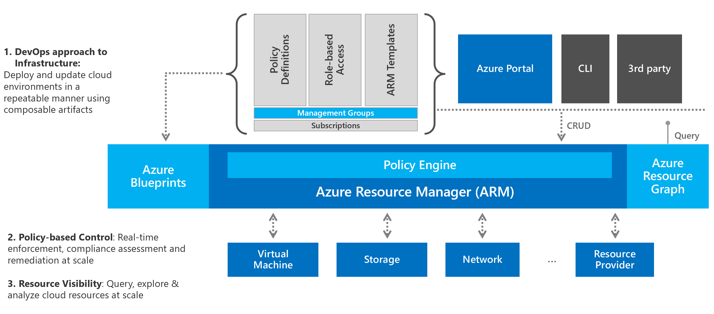
Azure Policy Primer
Within Azure, Governance refers to the ongoing process of managing, monitoring, and auditing the use of Azure resources.

Slide 7
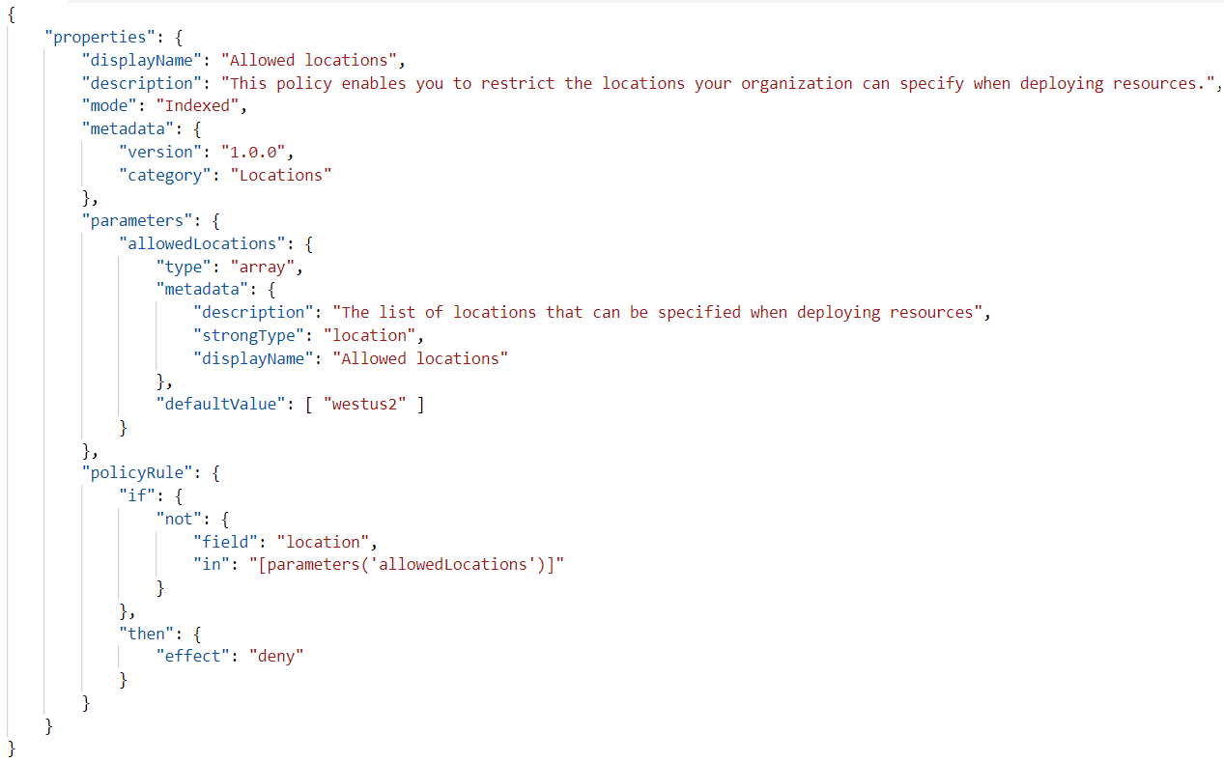
Evaluation Mode: all or indexed
Policy Condition
Policy Effect

Slide 8


Policy Hierarchy
Policies
Initiatives
Assignment Scope
Management Groups
Subscriptions
Resource Groups
Resources

Slide 9


Policy Enact
Azure CLI
Azure PowerShell
Azure Resource Manager
Resource Providers
ARM Templates
Azure SDK

Slide 10
Effects – Before resource create or update
Disabled
Determine whether the policy rule should be evaluated
Append And Modify
Add additional fields to the requested resource during creation or update
Deny
Prevent a resource request that doesn't match defined standards through a policy definition
Audit
Create a warning event in the activity log when evaluating a non-compliant resource

Slide 11
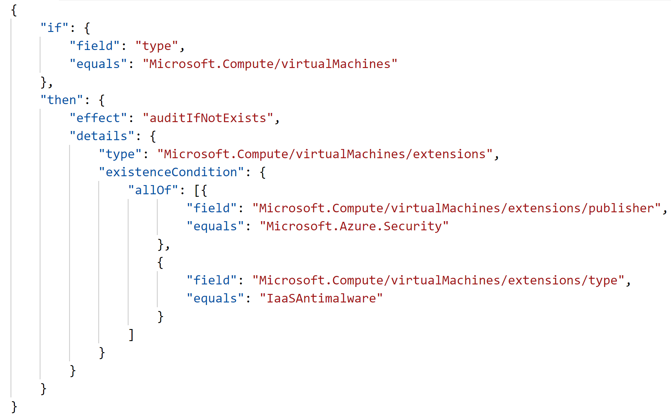
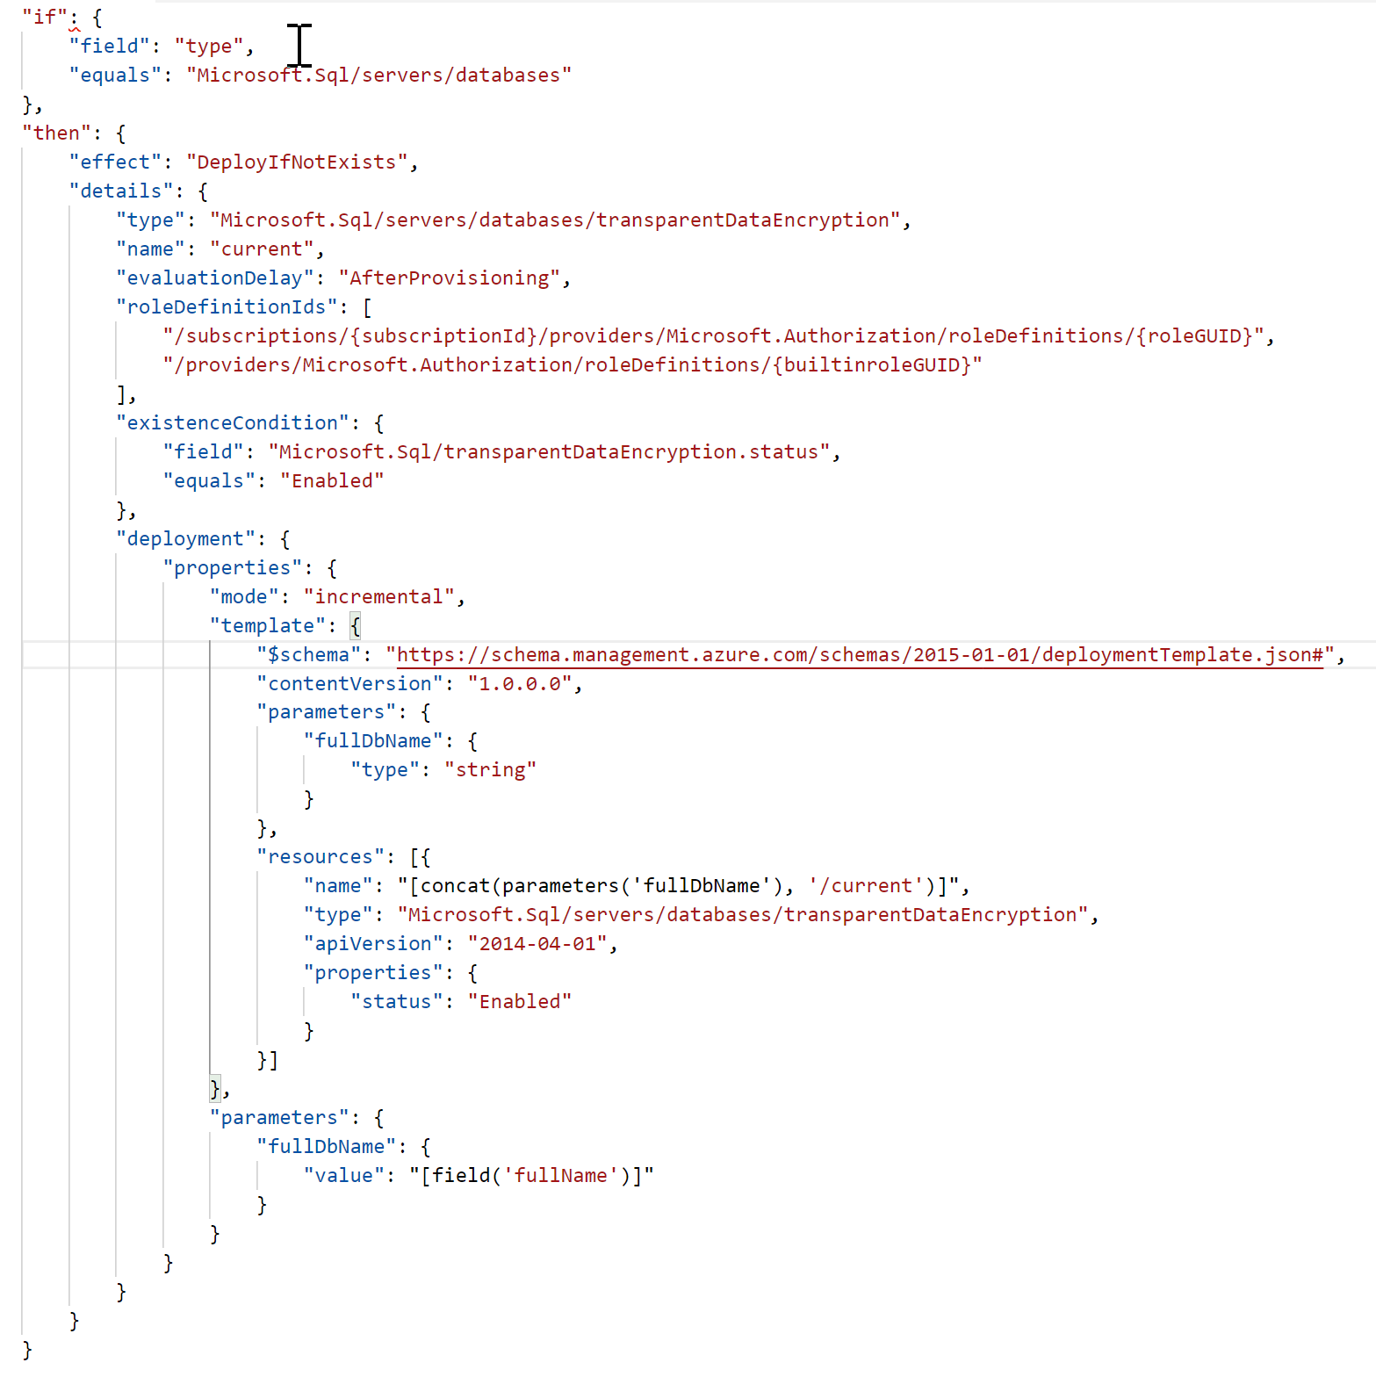
Effects - After resource create or update
AuditIfNotExists
[AINE] Verify the condition of related components for the resources that match ‘if’ policy rule!
DeployIfNotExists
[DINE] Executes a template deployment when the condition is met

Slide 12
Azure Policy Guest Configuration
Native capability to audit or configure operating system settings as code, both for machines running in Azure and hybrid Arc-enabled machines
Utilizes Azure Policy to dynamically assign configurations to machines
Guest configuration can be used in compliance and configuration management scenarios
Azure Policy (External and Environmental settings)
Guest Configuration (Internal and OS settings)
Compliance -> AINE
Configuration -> DINE

Slide 13
Azure Policy Guest Configuration
Support Windows and Linux Operating Systems
Supports both built-in and custom guest configurations
Custom guest configurations must be PowerShell 7.x compatible
Custom configurations are PowerShell DSC configurations
Can be used as a part of policy or VM guest configuration extension
Prerequisites
VM Extension (Azure VM) is installed (1.29.24 or above for configuration management)
Arc Agent 1.10.0 or above for On-premises systems
System Managed Identity (Azure VM)
Check for new or changed guest assignments every 5 minutes
Compliance re-evaluation happens every 15 minutes
Assignment evaluation happens sequentially

Slide 14
Azure Policy Guest Configuration
Portal Experience

Slide 15
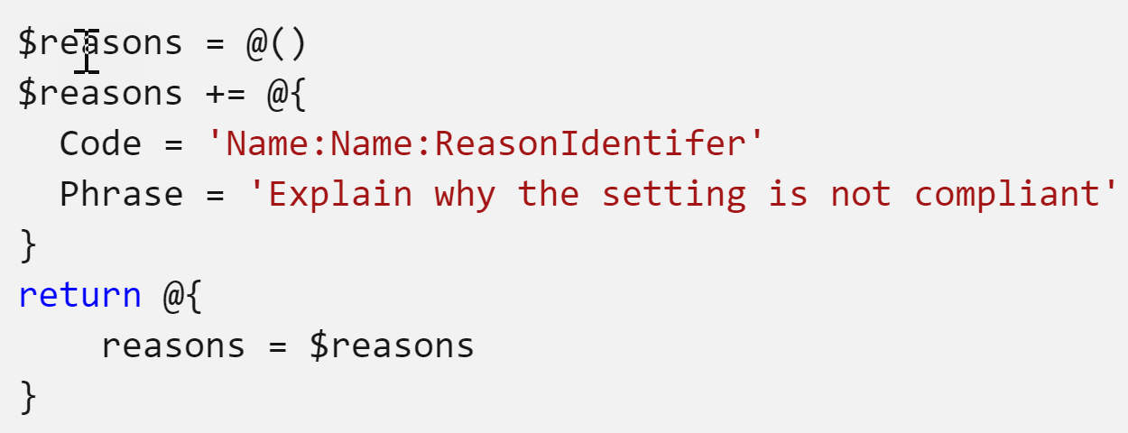
Custom Guest Configurations
Support Windows and Linux Operating Systems
Custom configurations on Windows must be PowerShell 7.x compatible and written using PowerShell DSC v3
Custom configurations on Linux must be PowerShell 7.2 Preview 6 and above compatible and written using DSC v3
Get method return requirements
If Reason isn't included, the service includes a "catch-all" behavior that compares the values input to Get and the values returned by Get, and provides a detailed comparison as Reason.

Slide 16
Guest Configuration Flow
Mode?
Test return is False
Run Test Method
Resource is non-compliant
Audit
Yes
Run Get Method to retrieve current state
AuditAndSet
No
Test return is False
Run Set Method
Resource is compliant
Yes
No

Slide 17
Azure Policy Guest Configuration
Custom Guest Configurations

Slide 18
Guest Configuration - Remediation
Custom guest configuration policy definitions using AuditIfNotExists (Compliance) are Generally Available, but definitions using DeployIfNotExists (Configure) with guest configuration are in preview.
One of the three assignment types determines if remediation is run
Audit – Report on the state of the machine, but don't make changes.
ApplyAndMonitor – Applied to the machine once and then monitored for changes. If the configuration drifts and becomes NonCompliant, it won't be automatically corrected unless remediation is triggered.
ApplyAndAutoCorrect – Applied to the machine. If it drifts, the local service inside the machine makes a correction at the next evaluation.

Slide 19
Azure Policy Guest Configuration
Remediation

Slide 20





Our Partners

Slide 21

Communities

Slide 22
Q & A

Slide 23
Feedback

Slide 24
THANK YOU!
Ravikanth Chaganti
@ravichaganti

